Slide 1
Threads
a new abstraction of program execution

Slide 2
What is a Thread?
Stream of instructions that OS can schedule to run independently
Think of procedure that runs independently from / concurrently with main program
Each one has its own, independent control flow
Multiple threads can belong to the same process

Slide 3
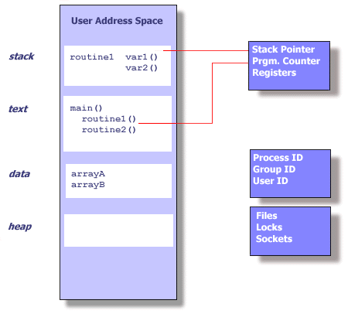

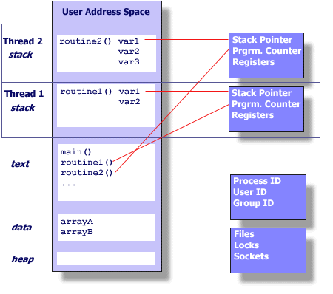
Process vs. Threads

Slide 4
Sharing between threads
What’s shared between threads
  Almost everything in the process
What they don’t share
  PC, registers, stack pointer, and stack

Slide 5
Benefits of Threading
Shared memory, easy to communicate information between threads
Lighter weight than processes
  only duplicate enough state to run independently
    faster to create threads than processes
    faster to switch between threads than processes

Slide 6
Thread programming
Linux pthreads using kernel-level threads
Thread prototypes: #include <pthread.h>
  > 60 functions
To compile:
gcc -lpthread prog.c -o prog

Slide 7
Basic operations on threads
Creating and starting a thread
  like an asynchronous procedure call
Joining with a thread
  blocks the calling thread until a target thread completes
  a typical operation when a thread needs to use the return value of the target-thread’s starting procedure

Slide 8
Thread Creation
int pthread_create (pthread_t *tid,
pthread_attr_t *attr,
void *(*func)(void *),
void *arg);
func : input parameter, the name of the user-defined function to be executed by the newly created thread.
  returns a void pointer, single void pointer argument
arg : input parameter, the argument to be passed to the function func

Slide 9
Thread Creation
int pthread_create (pthread_t *tid,
pthread_attr_t *attr,
void *(*func)(void *),
void *arg);
Why void * as argument type?
The argument type should:
  Work for all types and sizes of arguments
  Even work for different numbers of arguments

Slide 10
Thread Creation
int pthread_create (pthread_t *tid,
pthread_attr_t *attr,
void *(*func)(void *),
void *arg);
tid : output parameter, pointer to location where the id of the newly created thread will be stored.
attr : input parameter, pointer to structure specifying the thread’s attributes (e.g. stack size, etc.)
  If set to NULL, the system defaults are used

Slide 11
Threaded “hello, world”
/*
* hello.c - Pthreads "hello, world" program
*/
#include "csapp.h"
/* thread routine */
void *thread(void *vargp) {
printf("Hello, world!\n");
return NULL;
}
int main() {
pthread_t tid;
Pthread_create(&tid, NULL, thread, NULL);
exit(0);
}
Wrong!

Slide 12
Thread coordination
  Threads can only execute as long as their containing process exists
In the example, what could happen if the thread routine has not reached printf with the main thread reaching the end of main()?
We need to use join() to make the main thread wait for the other thread to finish

Slide 13
pthread_join()
int pthread_join(pthread_t thread,
void **value_ptr );
thread: input parameter, id of the thread to wait on
value_ptr: output parameter, value given to pthread_exit() by the terminating thread (which happens to always be a void *)
  Type is void ** because type of location to be updated is void *

Slide 14
Threaded “hello, world”
/*
* hello.c - Pthreads "hello, world" program
*/
#include "csapp.h"
/* thread routine */
void *thread(void *vargp) {
printf("Hello, world!\n");
return NULL;
}
int main() {
pthread_t tid;
Pthread_create(&tid, NULL, thread, NULL);
Pthread_join(tid, NULL);
exit(0);
}
Good!

Slide 15
Execution of threaded “hello, world”
main thread
Call Pthread_create()
Pthread_create() returns
peer thread
call Pthread_join()
main thread
waits for peer thread to terminate
printf()
return NULL;
(peer thread
terminates)
Pthread_join() returns
exit()
terminates
main thread and
any peer threads

Slide 16
Pop Quiz
What does this program output?
#include "csapp.h"
/* thread routine */
void *mythread(void *vargp) {
printf("Hello from the other thread\n");
return NULL;
}
int main() {
pthread_t tid;
Pthread_create(&tid, NULL, mythread, NULL);
printf("Hello from the main thread\n");
Pthread_join(tid, NULL);
exit(0);
}

Slide 17
Our previous example
No assumption about the statement execution order between threads is possible
The output of the main thread might happen before the output of thread mythread
printf() is thread-safe
    Even if called by 2 threads simultaneously, it is guaranteed that outputs won’t be mixed

Slide 18
Pop Quiz
#include "csapp.h"
/* thread routine */
void *mythread(void *vargp) {
printf("T.a\n");
printf("T.b\n");
return NULL;
}
int main() {
pthread_t tid;
printf("M.a\n");
Pthread_create(&tid, NULL,
mythread, NULL);
printf("M.b\n");
printf("M.c\n");
Pthread_join(tid, NULL);
printf("M.d\n");
exit(0);
}
Impossible statement orderings (printf output):
T.a
M.a
…
T.a
T.b
M.a
…
…
M.d
T.b
…
…
M.d
T.a
T.b

Slide 19
Pop Quiz
#include "csapp.h"
/* thread routine */
void *mythread(void *vargp) {
printf("T.a\n");
printf("T.b\n");
return NULL;
}
int main() {
pthread_t tid;
printf("M.a\n");
Pthread_create(&tid, NULL,
mythread, NULL);
printf("M.b\n");
printf("M.c\n");
Pthread_join(tid, NULL);
printf("M.d\n");
exit(0);
}
Possible statement orderings (printf output):
M.a
M.b
M.c
T.a
T.b
M.d
…
M.a
T.a
M.b
M.c
T.b
M.d
…
M.a
T.a
M.b
T.b
M.c
M.d
…
several more?

Slide 20
Practice exercise
int a = 0, b = 0;
Thread T1:
while (a == 0) ; (1)
print(4); (2)
b=1; (3)
b=0; (4)
print(A); (5)
Thread T2:
print(1); (1)
a=1; (2)
while (b==0) ; (3)
print(3); (4)
Write all possible outputs. Assume output is not buffered.

Slide 21
Output: “14A”
T1
T2
Comments
T1 enters while loop
T2 prints 1
a is set to 1
T2 enters while loop
T1 exits while loop
T1 prints 4
b is set to 1
b is set to 0
T1 prints A
T2 never exits while loop
(1)
(1)
(2)
(3)
(3)
context switch
context switch
(1)
(2)
(3)
(4)
(5)
context switch

Slide 22
Data race
A program has a data race if it is possible for a thread to modify an addressable location at the same time that another thread is accessing the same location
  The result/correctness depends on the sequence/timing of events; i.e., how things end up being scheduled.

Slide 23
Example: 2b
Q: Are there any race conditions in this code?
void *foo(void *vargp) {
int id;
id = *((int *)vargp);
printf("Thread %d\n", id);
}
int main() {
pthread_t tid[2];
int i;
for (i = 0; i < 2; i++)
Pthread_create(&tid[i], NULL, foo, &i);
Pthread_join(tid[0], NULL);
Pthread_join(tid[1], NULL);
}
Yes!

Slide 24
Flaw in code
Inside the loop several threads are created
  Variable i is visible in all threads
  Variable i is modified in main after each thread is created
The threads may not access the parameter fast enough to read the value “assigned” to them

Slide 25
Example 2a
Q: Are there any race conditions in this code?
void *foo(void *vargp) {
int myid;
myid = *((int *)vargp);
Free(vargp);
printf("Thread %d\n", myid);
}
int main() {
pthread_t tid[2];
int i, *ptr;
for (i = 0; i < 2; i++) {
ptr = Malloc(sizeof(int));
*ptr = i;
Pthread_create(&tid[i], NULL, foo, ptr);
}
Pthread_join(tid[0], NULL);
Pthread_join(tid[1], NULL);
}
No!

Slide 26
Question
Outline an approach to avoid race conditions that does not use malloc/free

Slide 27
Example: 2c
Answer: Simply pass in the int directly!
void *foo(void *vargp) {
int id;
id = (int)vargp;
printf("Thread %d\n", id);
}
int main() {
pthread_t tid[2];
int i;
for (i = 0; i < 2; i++)
Pthread_create(&tid[i], NULL, foo, (void *)i);
Pthread_join(tid[0], NULL);
Pthread_join(tid[1], NULL);
}

Slide 28
Previous example
Pro: No added overhead due to malloc/free
Con: Assumes that pointer datatype is at least bigger than size of int
  May not be true on all systems

Slide 29
Threads are not hierarchical
Unlike processes, a thread doesn’t have a parent or children – threads are peers
Any thread can pthread_join any other thread

Slide 30
Threads are not hierarchical
void *go1(void *ignored) {
sleep(1);
printf("1\n");
return NULL;
}
void *go2(void *th) {
pthread_join(*(pthread_t *)th, NULL);
printf("2\n");
return NULL;
}
int main() {
pthread_t one, two;
pthread_create(&one, NULL, go1, NULL);
pthread_create(&two, NULL, go2, &one);
pthread_join(two, NULL);
return 0;
}
Prints 1
then 2

Slide 31
Thread termination
4 possible ways
  Implicit termination: the thread routine returns; usually what we’ll use
  Explicit termination: the thread calls pthread_exit()
  Process exit: any thread calls exit(), which terminates the process and all associated threads; maybe not what you really want
  Thread cancellation: another thread calls pthread_cancel() to terminate a specific thread

Slide 32
Thread termination functions
void pthread_exit(void *val);
  terminates current thread, with a return value equal to the pointer val
  Note: Upon termination, a thread releases its runtime stack.
  Therefore the pointer should point to:
    a global variable, or
    a dynamically allocated variable.

Slide 33
Thread reaping
Threads are reaped by pthread_join()
  int pthread_join(pthread_t tid, void **val)
  on success, *val is the return value of the terminated thread

Slide 34
Return value example
void *get_rand_num(void *args) {
int *nump = malloc(sizeof(int));
srand(getpid());
*nump = rand();
printf("Random number: %d\n", *nump);
return nump;
}
int main() {
pthread_t tid;
void *ptr = NULL;
pthread_create(&tid, NULL, get_rand_num, NULL);
pthread_join(tid, &ptr);
printf("Random number: %d\n", *(int *)ptr);
return 0;
}

Slide 35
Notes
Our previous example had the thread just return from the thread routine
In this case the call to pthread_exit()is implicit
  The return value of the function serves as the argument to the (implicitly called) pthread_exit()

Slide 36
Pop Quiz
What is the output?
void *thread (void *vargp) {
int arg = *((int*)vargp);
return &arg;
}
int main () {
pthread_t tid;
int thread_arg = 0xDEADBEEF;
int *ret_value;
pthread_create(&tid, NULL, thread, &thread_arg);
pthread_join(tid, (void **)(&ret_value));
printf("%X\n", *ret_value);
return 0;
}

Slide 37
Thread termination
void pthread_exit(void *val);
  val must not point to an object local to thread, as these disappear when the thread terminates

Slide 38
pthread_exit vs exit
pthread_exit
  Terminates the calling thread.
  Does not terminate the entire process/other threads.
exit
  Terminates the entire process
  All threads are gone
The main thread is a little special
  pthread_exit() waits for all threads in the process to terminate

Slide 39
Pop Quiz
What is the output?
void *thread (void *p) {
printf("hello, world\n");
}
int main () {
pthread_t tid;
pthread_create(&tid, NULL, thread, NULL);
pthread_exit(NULL);
}

